Slide 1
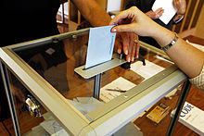
Popular Base of American Electoral Politics: Suffrage and Turnout
From Is This Any Way to Run a Democratic Election?
By
Stephen J. Wayne

Slide 2
Copyright Notice
Certain materials in this presentation are included under the fair use exemption of the U.S. Copyright Law and have been prepared with the multimedia fair use guidelines and are restricted from further use.

Slide 3
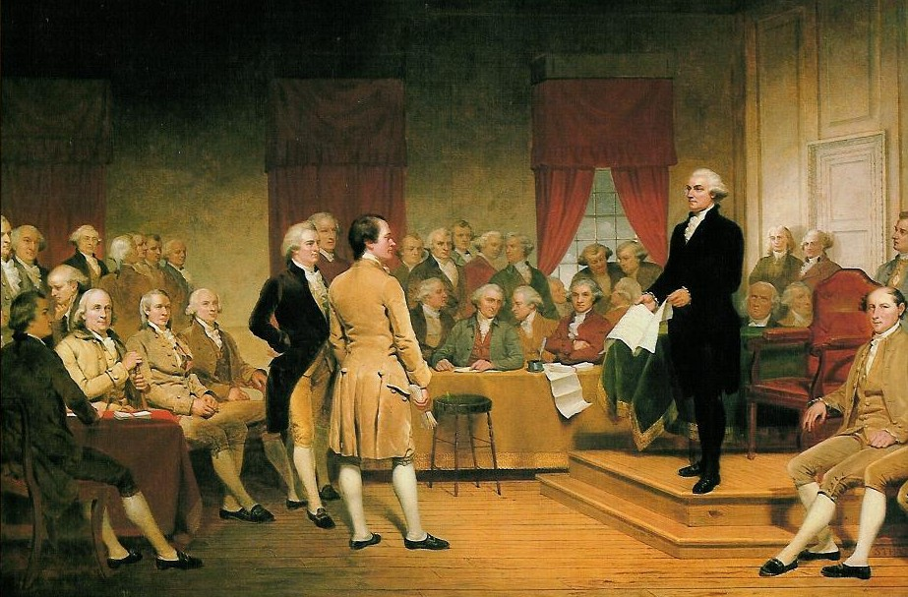
Suffrage in American Elections
1787: Who should vote? The Founders decided not to decide

Slide 4
Expanding the Right to Vote
By the 1830’s, most states had removed religion and property ownership as voting conditions
In most northern states, African American males allowed to vote
15th Amendment, ratified in 1870, removed race and color as bars to suffrage
1869: Wyoming first territory to grant women the right to vote, also first state in 1890
By 1904, only four states allowed women to vote

Slide 5
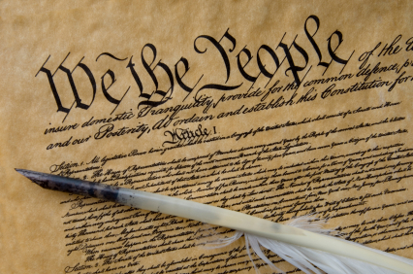
Reform
17th Amendment (1871)
18th Amendment (1913)
19th Amendment (1920)
20th Amendment (1933)
24th Amendment (1964)
26th Amendment (1971)

Slide 6
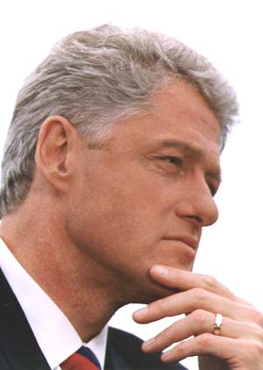
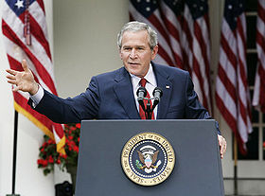
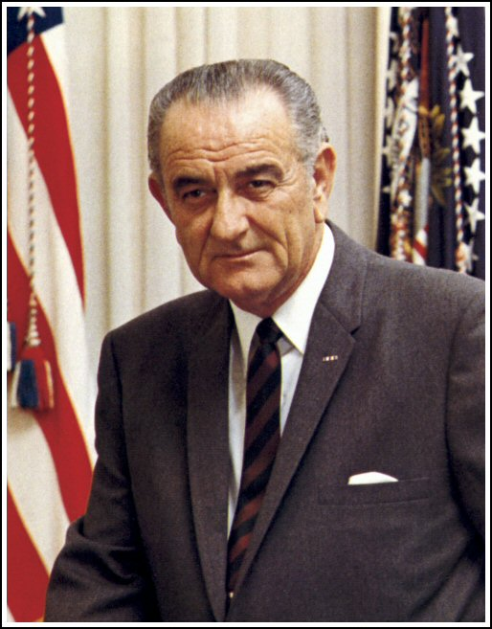
Reform
1964 Civil Rights Act
1965 Voting Rights Act
1993 “Motor Voter” bill
2002 “Help America Vote” Act

Slide 7
Legal Limits
Jail – between 4.5 and 5 million disenfranchised
Mental institutions
Minority vote suppression
Low-income disenfranchisement
Skills and literacy deficits

Slide 8
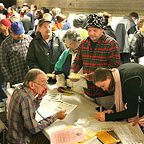
Ups and Downs of Voter Turnout
1996 presidential election, 51.7% of eligible voters did not!
2000 54.2% turnout
2004 turnout 60.3%
Non-presidential elections turnout usually 30 – 40%
Primaries, 2004 and 2006: turnout averaged 15% of VAP

Slide 9
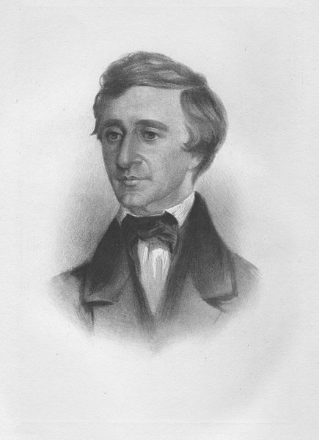
19th Century Turnout
After 1800: Development of the party system raises turnout
Corruption and fraud increase, too
Poll taxes enacted to pay for election costs
Literacy tests and taxes used to prevent Blacks and poor Whites from voting
Decrease in competition after 1865 reduces turnout
Districting used to create “safe seats”

Slide 10
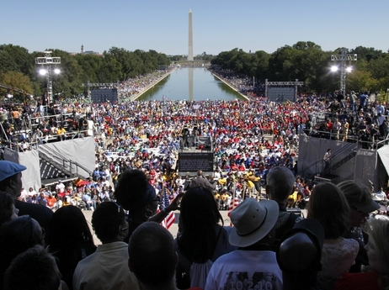
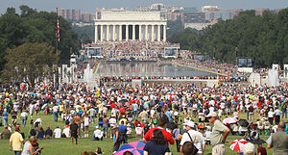
Contemporary Trends
Introduction of Australian Ballot, Party Primaries empowered voters, but did not raise turnout
1930s realignment raised levels of participation, but did not reach 19th Century
1960s turnout declines
Partisan parity has led to an increase in turnout: every vote counts

Slide 11
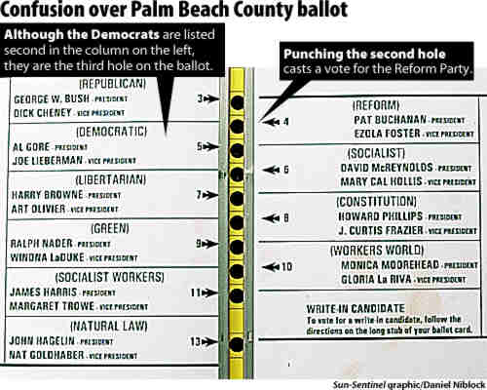
Influences in Voting
People who don’t, say they do… why do they lie?
Duty versus lack of motivation
Cynicism
Apathy
Socially inactive
Time restraints
Conflicted emotions
Complex rules
Lack of excitement

Slide 12
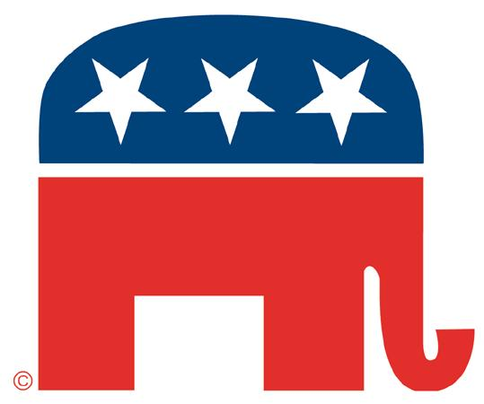
Why People Choose to Vote
Party membership
Well-defined sense of issues and values, political efficacy
Socially active, civically responsible
Education
Age
Income

